Slide 1
Chapter 1
Introduction to web development with PHP

Slide 2
Applied objectives
Use the XAMPP control panel to start or stop Apache or MySQL when it is running on your own computer.
Deploy a PHP application on your own computer.
Run a web application that’s on your own computer (1) by entering its URL into the address bar of a browser or (2) by getting and using an index of the applications that are on the web server.
View the source code for a web page in a web browser.

Slide 3
Knowledge objectives
Describe the components of a client-server architecture.
Describe HTTP requests and responses.
Distinguish between the way a web server processes static web pages and dynamic web pages.
Explain what these software components do as a web application runs: Apache, PHP, Chrome, and MySQL.
Describe the difference between MySQL and MariaDB.
Describe the way a PHP application is deployed on your own computer or on an Internet server.
Describe the components of an HTTP URL.
Describe what happens if you omit one or more parts of a URL when you try to run an application or if you code a URL that specifies a directory that doesn’t contain a default page.
Describe the benefits of using an IDE like NetBeans for application development.

Slide 4
The architecture of a web application

Slide 5
The architecture of the Internet

Slide 6
Key terms for client-server systems
server
client
network
router
Local Area Network (LAN)
Wide Area Network (WAN)
Internet
Internet Exchange Point (IXP)
Internet Service Provider (ISP)

Slide 7
How static web pages are processed

Slide 8
A simple HTTP request
GET / HTTP/1.1
Host: www.example.com
A simple HTTP response
HTTP/1.1 200 OK
Content-Type: text/html
Content-Length: 136
Server: Apache/2.2.3
<html>
<head>
<title>Example Web Page</title>
</head>
<body>
<p>This is a sample web page</p>
</body>
</html>

Slide 9
Two protocols that web applications depend upon
HyperText Transfer Protocol (HTTP)
Transmission Control Protocol/Internet Protocol (TCP/IP)

Slide 10
How dynamic web pages are processed with PHP

Slide 11
Key terms for web pages
HyperText Markup Language (HTML)
static web page
HTTP request
HTTP response.
dynamic web page
PHP interpreter
database server
render
round trip

Slide 12
Web browsers
Chrome
Firefox
Internet Explorer
Edge
Safari
Opera
Web servers
Apache
IIS

Slide 13
Server-side languages
PHP
JSP
ASP.NET
Perl
Python
Database servers
MySQL
Oracle
DB2
MS SQL Server

Slide 14
Highlights in the history of PHP
Version Year Description
2 1995 Personal Home Page
3 1998 PHP: Hypertext Processor
4 2000 Introduced the Zend Engine
5 2004 Introduced the Zend Engine 2 Improved support for OOP Added the PHP Data Objects extension
6 N/A Abandoned and never released
7 2015 Introduced the Zend Engine 3 Improved performance

Slide 15
Highlights in the history of MySQL
Version Year Description
3.23 1995 The original version of MySQL
4.0 2003 Introduced support for unions.
4.1 2004 Introduced support for subqueries and prepared statements.
5.0 2005 Introduced support for stored procedures, triggers, views, and transactions.
5.1 2008 Introduced support for row-based replication and server log tables.
5.5 2010 Default storage engine now supports referential integrity.
5.6 2011 Introduced support for big data.
5.7 2017 Included security improvements and other enhancements.

Slide 16
MySQL notes
MySQL is owned and sponsored by MySQL AB, a for-profit firm.
In 2008, Sun Microsystems acquired MySQL AB.
In 2009, Oracle Corporation acquired Sun Microsystems.
In 2009, many of the original developers of MySQL left MySQL AB and begin working on different forks of the open-source code. One of the most popular of these forks is MariaDB.
In 2012, several Linux distributions, as well as Wikipedia and Google, began to replace MySQL with MariaDB.
MariaDB intends to maintain high compatibility with MySQL so it can work as a drop-in replacement for MySQL.
XAMPP 5.6 and later include MariaDB, not MySQL.

Slide 17
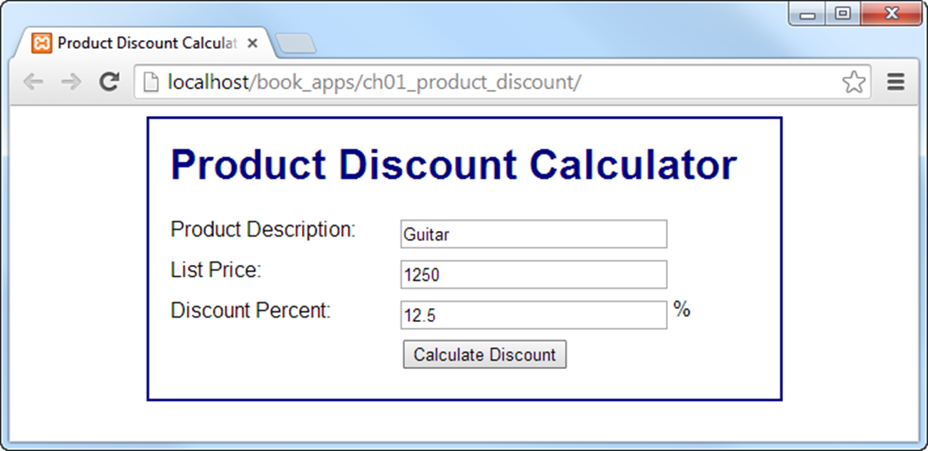
The first page of an application

Slide 18
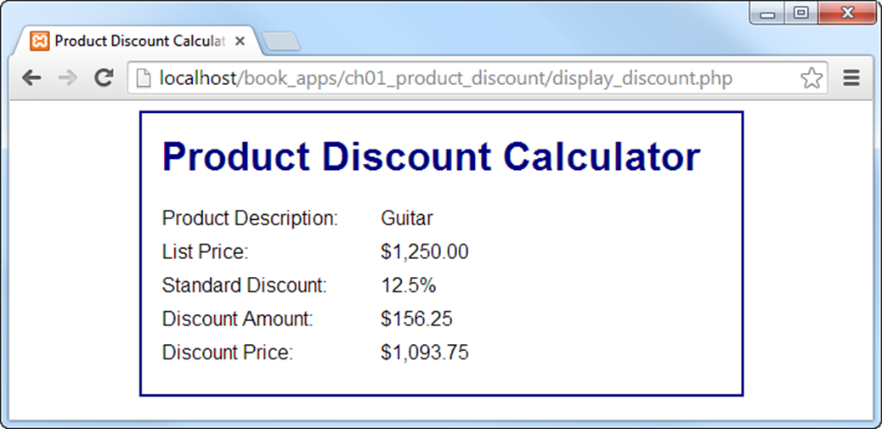
The second page (display_discount.php)

Slide 19
The HTML file (index.html) (part 1)
<!DOCTYPE html>
<html>
<head>
<title>Product Discount Calculator</title>
<link rel="stylesheet" type="text/css" href="main.css">
</head>
<body>
<main>
<h1>Product Discount Calculator</h1>
<form action="display_discount.php" method="post">
<div id="data">
<label>Product Description:</label>
<input type="text" name="product_description"><br>
<label>List Price:</label>
<input type="text" name="list_price"><br>

Slide 20
The HTML file (index.html) (part 2)
<label>Discount Percent:</label>
<input type="text" name="discount_percent">
<span>%</span><br>
</div>
<div id="buttons">
<label>&nbsp;</label>
<input type="submit" value="Calculate Discount"><br>
</div>
</form>
</main>
</body>
</html>

Slide 21
The CSS file (main.css) (part 1)
body {
font-family: Arial, Helvetica, sans-serif;
margin: 1em;
padding: 0;
}
main {
display: block;
width: 450px;
margin: 0 auto;
padding: 1.5em;
background: white;
border: 2px solid navy;
}
h1 {
color: navy;
}
label {
width: 10em;
padding-right: 1em;
float: left;
}

Slide 22
The CSS file (main.css) (part 2)
#data input {
float: left;
width: 15em;
margin-bottom: .5em;
}
#data span {
padding-left: .25em;
}
#buttons input {
float: left;
margin-bottom: .5em;
}
br {
clear: left;
}

Slide 23
The PHP file (display_discount.php) (part 1)
<?php
// get the data from the form
$product_description = $_POST['product_description'];
$list_price = $_POST['list_price'];
$discount_percent = $_POST['discount_percent'];
// calculate the discount
$discount = $list_price * $discount_percent * .01;
$discount_price = $list_price - $discount;
// apply currency formatting to the dollar and percent amounts
$list_price_formatted = "$".number_format($list_price, 2);
$discount_percent_formatted = number_format
($discount_percent, 1)."%";
$discount_formatted = "$".number_format($discount, 2);
$discount_price_formatted = "$".number_format($discount_price,2);
// escape the unformatted input
$product_description_escaped =
htmlspecialchars($product_description);
?>

Slide 24
The PHP file (display_discount.php) (part 2)
<!DOCTYPE html>
<html>
<head>
<title>Product Discount Calculator</title>
<link rel="stylesheet" type="text/css" href="main.css">
</head>
<body>
<main>
<h1>Product Discount Calculator</h1>
<label>Product Description:</label>
<span><?php echo $product_description_escaped; ?></span><br>
<label>List Price:</label>
<span><?php echo $list_price_formatted; ?></span><br>

Slide 25
The PHP file (display_discount.php) (part 3)
<label>Standard Discount:</label>
<span><?php echo $discount_percent_formatted; ?></span><br>
<label>Discount Amount:</label>
<span><?php echo $discount_formatted; ?></span><br>
<label>Discount Price:</label>
<span><?php echo $discount_price_formatted; ?></span><br>
</main>
</body>
</html>

Slide 26
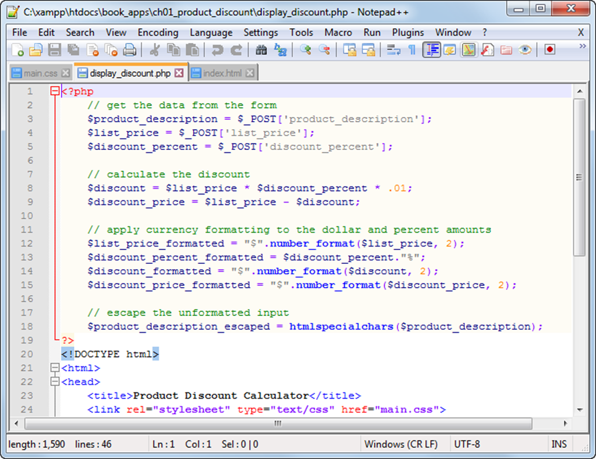
Notepad++ with three tabs open

Slide 27
How to open files in Notepad++
Use the Open button in the toolbar.
Right-click on the file in Windows Explorer and select Edit with Notepad++.
How to save the current file
Use the Save button in the toolbar.
Press Ctrl+S.
How to save all open files
Use the Save All button.

Slide 28
How to close the current file in Notepad++
Use the Close button in the toolbar.
How to close all open files
Use the Close All button.
How to open a new file in a new tab
Use the New button in the toolbar.

Slide 29
How to change the Notepad++ style for comments
Start the Settings→Styler Configurator command.
Select PHP in the language list and COMMENT in the style list.
Change the font name and font size in the drop-down lists to the blank entries at the top of the lists.
Repeat this for COMMENTLINE for the PHP language, for COMMENT for the HTML language, and for COMMENT for the CSS language.

Slide 30
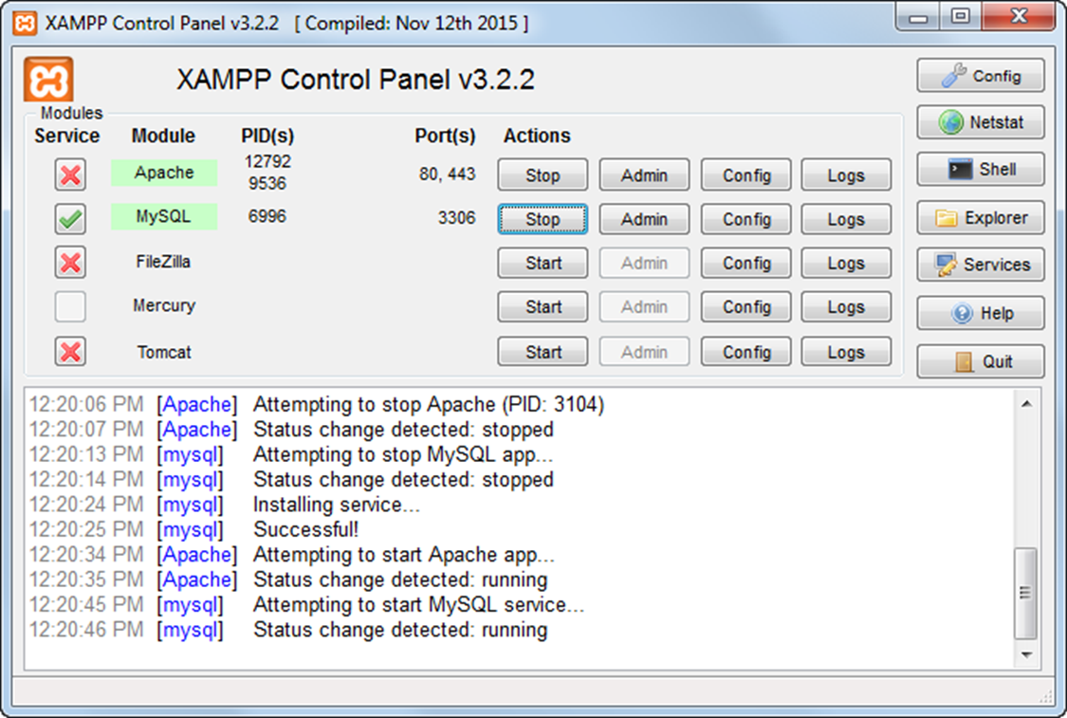
The XAMPP control panel

Slide 31
How to start the XAMPP control panel
Select the XAMPP Control Panel item from the Windows Start menu or double-click on the XAMPP icon on your desktop.
How to start and stop Apache or MySQL
Click on its Start or Stop button.
To start Apache or MySQL automatically when your computer starts, click the Services button in the XAMPP control panel.

Slide 32
About XAMPP
XAMPP is a free, open-source web server package.
The package consists of Apache, MySQL, and interpreters for PHP.
XAMPP can be easily installed.
XAMPP is available for Windows, Linux, Solaris, and Mac OS X systems (the X in XAMPP stands for cross-platform).

Slide 33
The directories for a PHP app on a local server

Slide 34
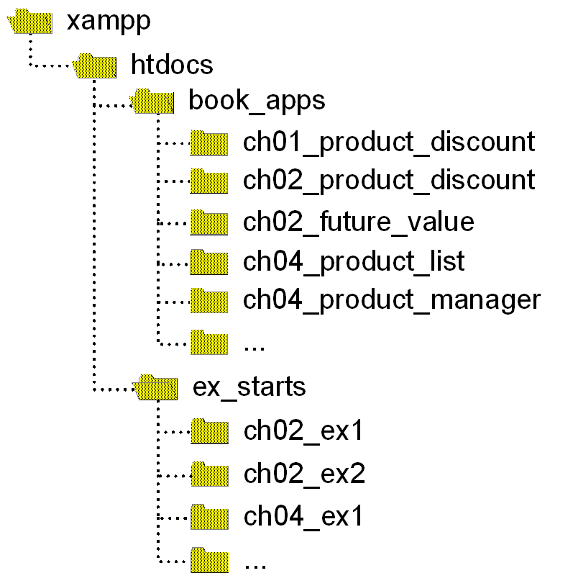
The structure for book_apps and ex_starts

Slide 35
How to deploy a PHP application on a local server
Copy all of the directories and files for an application to the \xampp\htdocs directory on the server.
How to deploy the downloadable applications on a local server
Copy the book_apps and ex_starts directories and all their contents to the \xampp\htdocs directory on the server.
How to deploy an application on an Internet server
Use an FTP (File Transfer Protocol) program to upload the tested directories and files to the htdocs directory of the Apache web server.

Slide 36
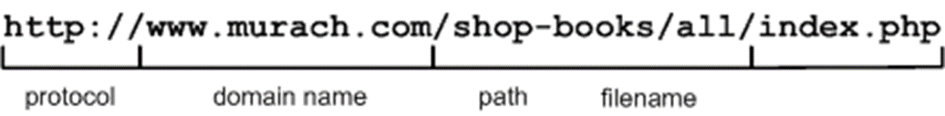
The components of an HTTP URL
What happens if you omit parts of a URL
If you omit the protocol, the default of http:// will be used.
If you omit the filename, one of the default filenames for the Apache web server will be used: index.htm, index.html, or index.php.
If you omit the filename and there is no default file, Apache will display an index of the files and directories in the path.

Slide 37
Requesting pages from an Internet web server
A request for a specific page
http://www.murach.com/shop-books/all/index.php
A request for the default (home) page of a website
http://www.murach.com/
Requesting applications from a local web server
A request for the default page in an application directory
http://localhost/book_apps/ch01_product_discount/
A request for a directory with no default page
http://localhost/book_apps/

Slide 38
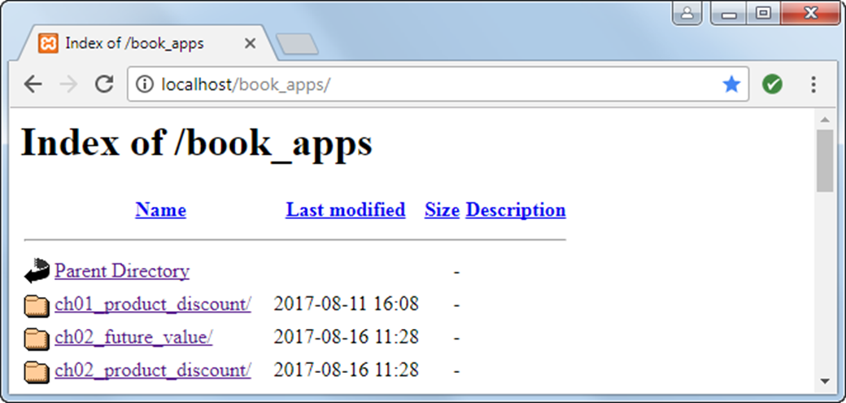
An index of the apps in the book_apps directory

Slide 39
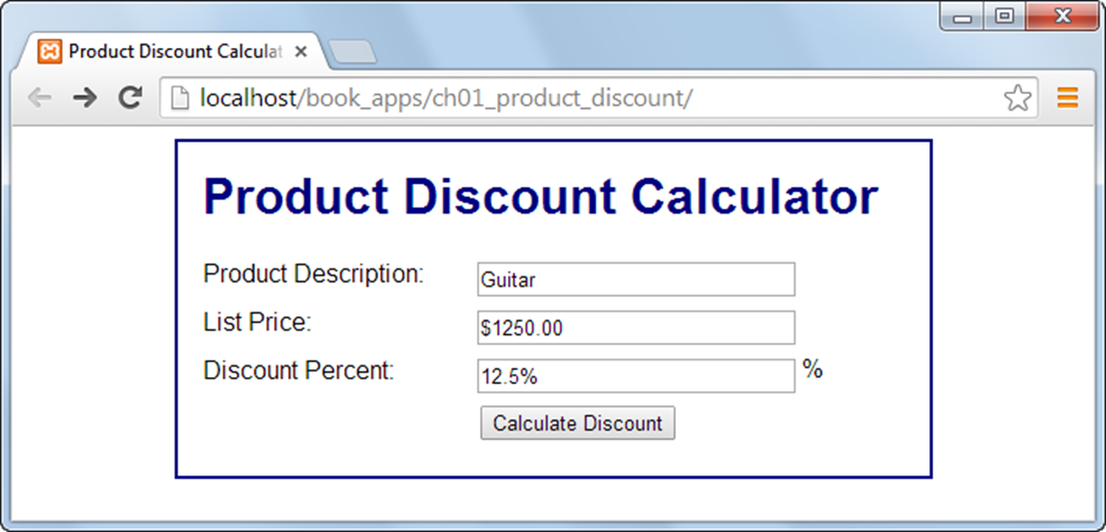
The Product Discount application in Chrome

Slide 40
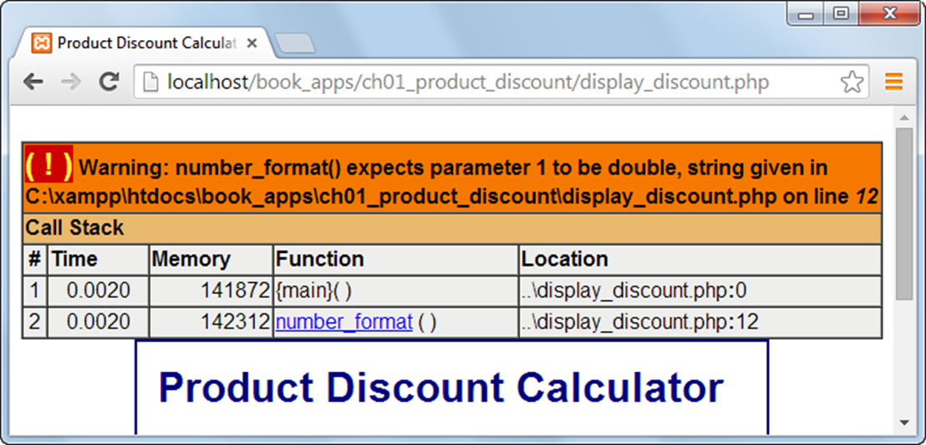
An error displayed in Chrome

Slide 41
How to test a PHP page for the first time
Make sure the Apache and MySQL servers are running.
Start a web browser and enter the URL for the application as shown in the last figure.
Test the page by entering both valid and invalid data, clicking on all links, and so on.
How to retest a PHP page after changes
Click the Reload or Refresh button in the browser.

Slide 42
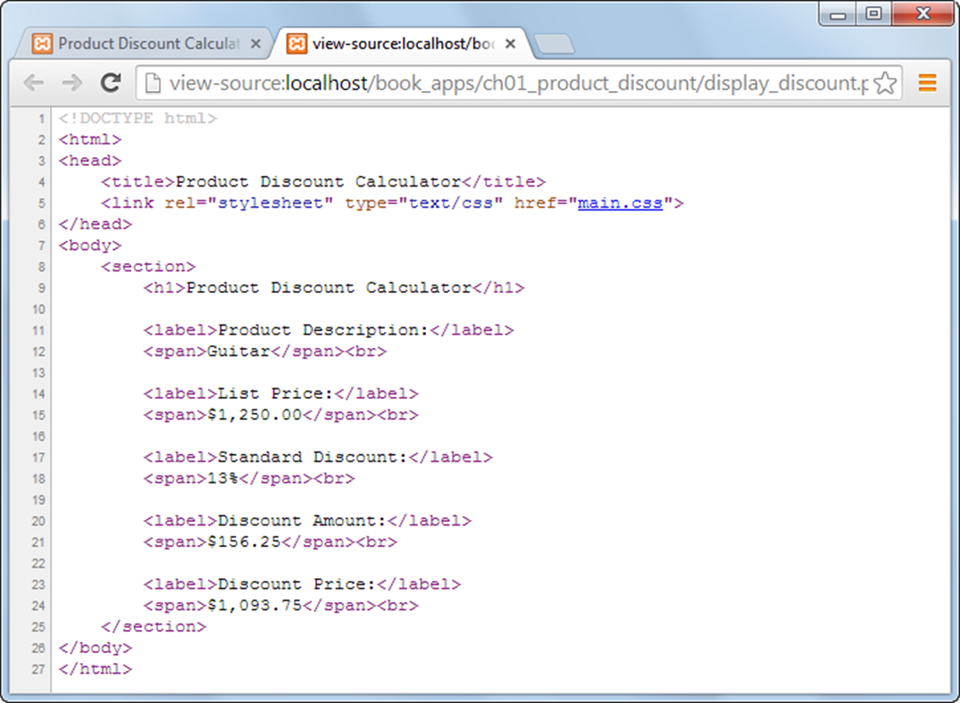
The source code for a PHP page

Slide 43
How to view the source code for a page in Chrome and Firefox
Right-click the page, then select the ViewPage Source command.
How to view the source code for a page in IE and Edge
Right-click on the page, then select the View Source command.
Note about Microsoft Edge
The View Source command isn’t available by default for this browser. To enable it, you can press F12 to display the Developer Tools. Then, when you select the View Source command, the source code will be displayed in the Debugger tab within the Developer Tools window.

Slide 44
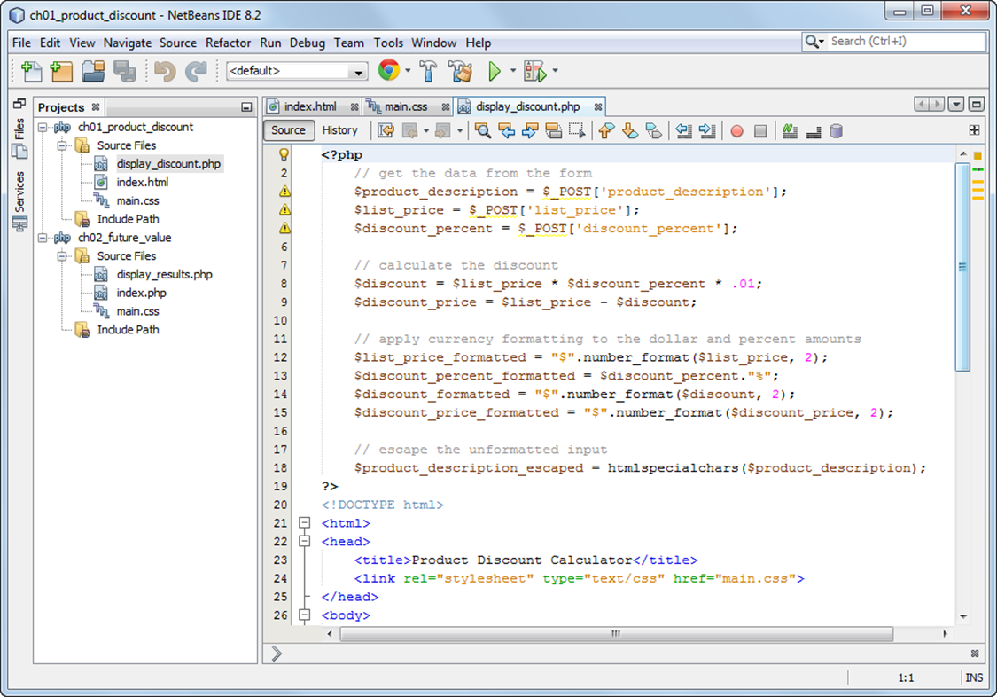
NetBeans with three files in a project open

Slide 45
How to work with NetBeans projects
To open a project, use the Open Project button in the toolbar.
To start a new project, use the New Project button in the toolbar.
To close a project, right-click on the project in the Projects tab and select the Close command from the resulting menu.
How to work with files
To open a file, use the Projects tab to navigate to the file and double-click the file.
To start a new file, select the project and click the New File button in the toolbar.

Slide 46
About NetBeans
NetBeans is an Integrated Development Environment (IDE) for developing PHP applications.
NetBeans can make it easier to create, edit, and test the HTML, CSS, and PHP files that you need for a web application.
About NetBeans projects
A NetBeans project consists of a top-level directory that contains the subdirectories and files for an application.
Netbeans adds an nbproject subdirectory that contains the extra files that NetBeans needs for managing the project.
Mac OS X note
To enable right-clicking with Mac OS X, you can edit the system preferences for the mouse.

Slide 47
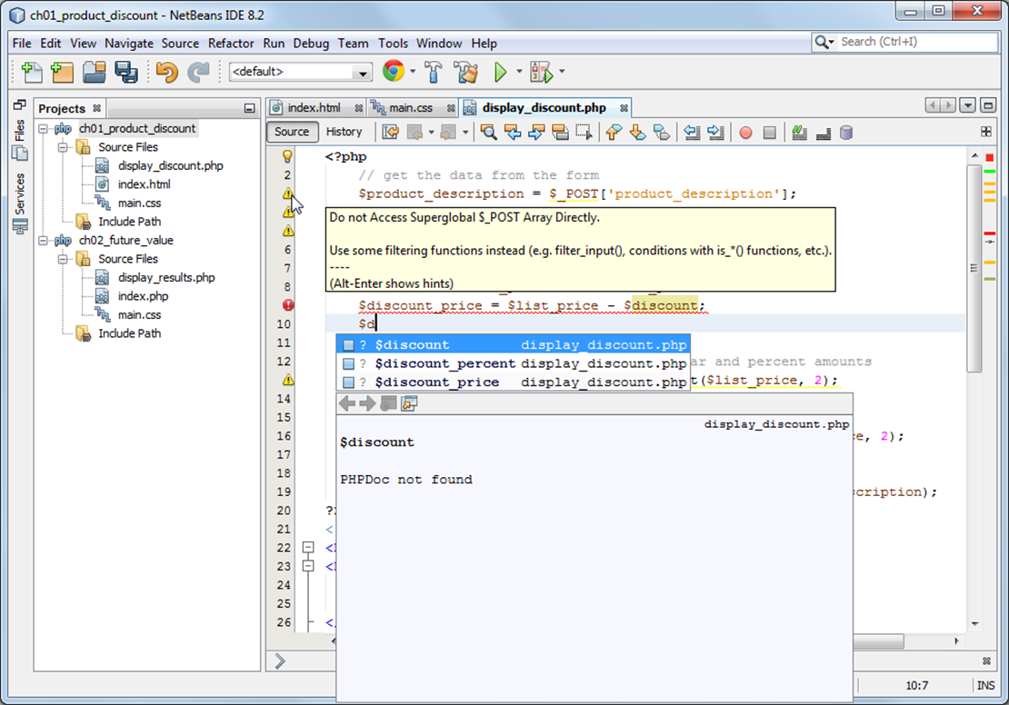
Auto-completion and error marking in NetBeans

Slide 48
How to edit a PHP file with NetBeans
Use normal editing techniques as you enter PHP code.
When you see an auto-completion list, you can highlight an entry and press the Enter key to enter it into your code or you can double-click on it.
If you see a red error icon at the start of a line that you have entered, you should fix whatever errors the line contains before you test the application.
How to test a PHP application with NetBeans
To run the current project, click on the Run Project button in the toolbar or press F6.
To run other projects, right-click on the project and select the Run command.
To run a file, right-click on the file and select the Run command.

Slide 49
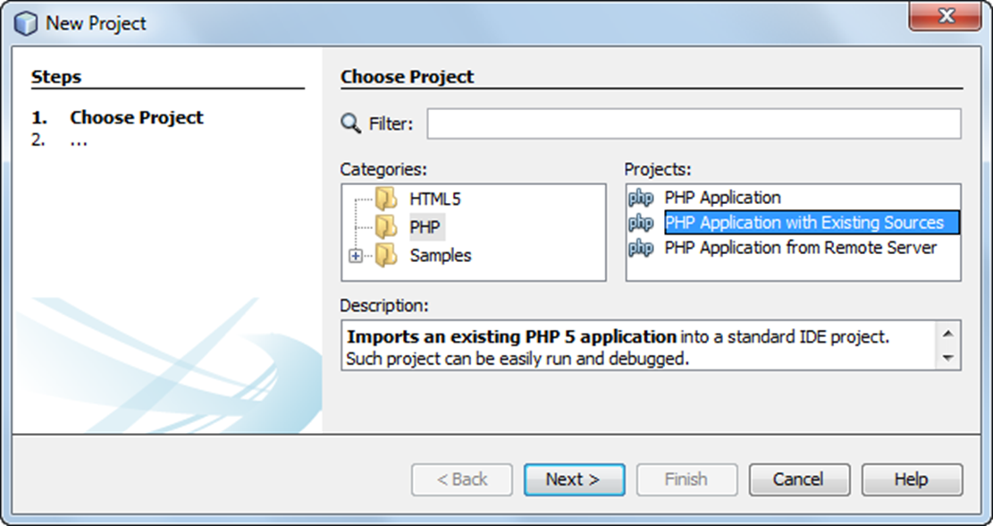
The dialog box for starting a new project

Slide 50
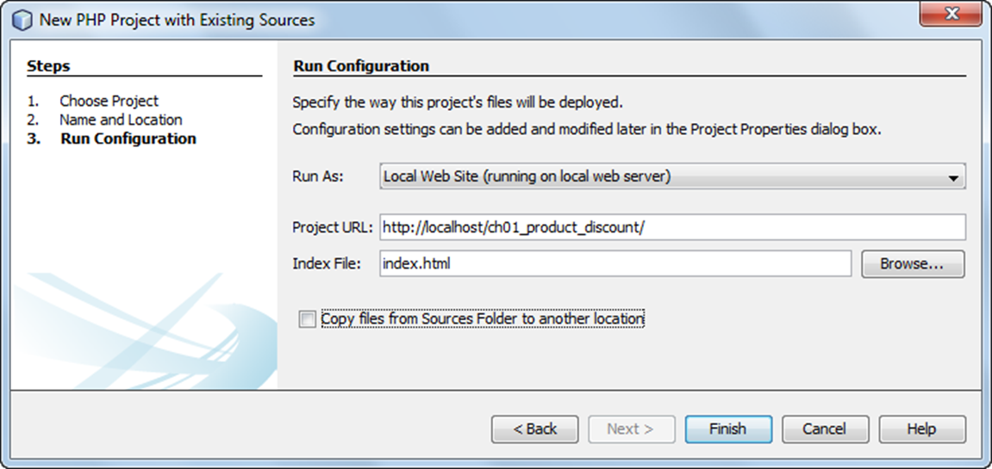
The dialog box for configuring a project

Slide 51
How to check the run configuration for a project
Right-click on a project in the Projects tab and select the Properties command.
Then, click on Run Configuration in the Categories list and check the Project URL.
How to import a project
Use the New Project command, but select PHP Application with Existing Sources in the Projects list.
This will step you through the import procedure.
In the third step, you are asked to check the run configuration. Here, you need to make sure the URL for running the project is correct.

